Slide 1
Lecture 11: Practical Guide to Tuning Deep Neural Networks – Part 2
Instructor: Yang Xu

Slide 2
Outline
L2 regularization
Dropout regularization
Vanishing/Exploding gradients
Gradient checking

Slide 3
Regularization
Use regularization to avoid overfitting

Slide 4
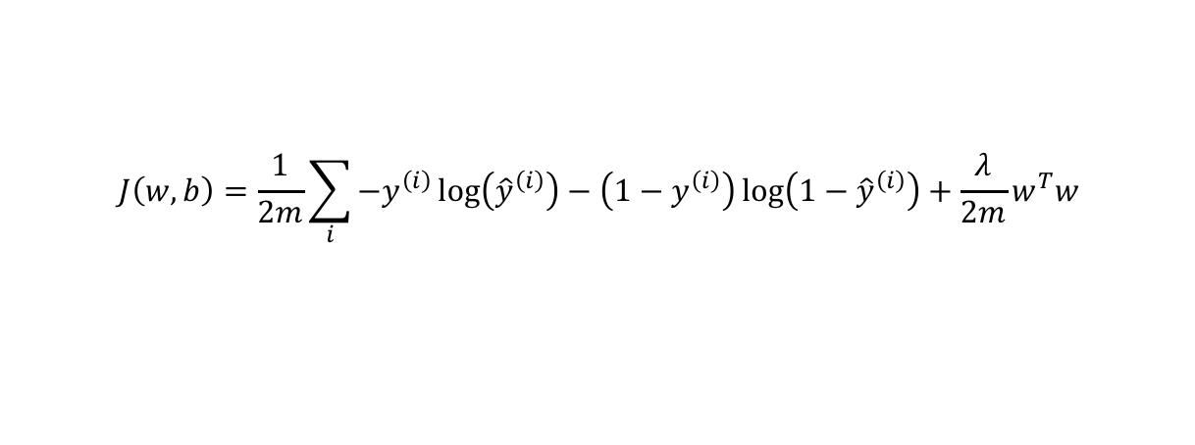
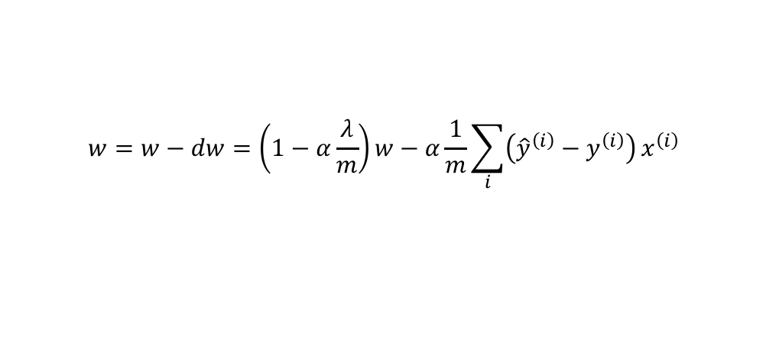
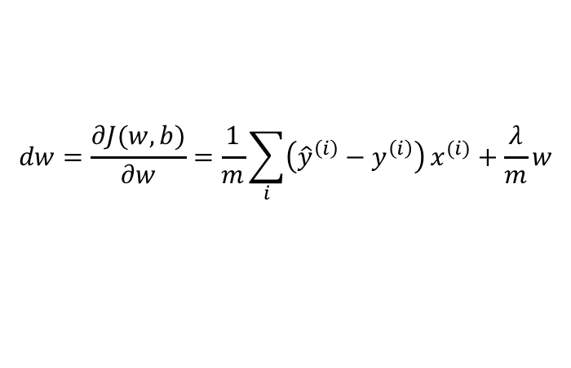
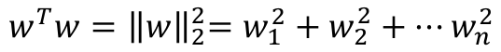
L2 regularization for logistic regression
$$J\left(w,b\right)=\frac{1}{2m}\sum_{i}{−y^{\left(i\right)}\log\left({\hat{y}}^{\left(i\right)}\right)−\left(1−y^{\left(i\right)}\right)\log\left(1−{\hat{y}}^{\left(i\right)}\right)}+\frac{λ}{2m}w^{T}w$$
$$w^{T}w{=\left\|w\right\|}_{2}^{2}=w_{1}^{2}+w_{2}^{2}+⋯w_{n}^{2}$$
$$dw=\frac{∂J(w,b)}{∂w}=\frac{1}{m}\sum_{i}{\left({\hat{y}}^{\left(i\right)}−y^{\left(i\right)}\right)}x^{(i)}+\frac{λ}{m}w$$
$$w=w−dw=\left(1−α\frac{λ}{m}\right)w−α\frac{1}{m}\sum_{i}{\left({\hat{y}}^{\left(i\right)}−y^{\left(i\right)}\right)}x^{\left(i\right)}$$
Minimize cost + complexity

Slide 5
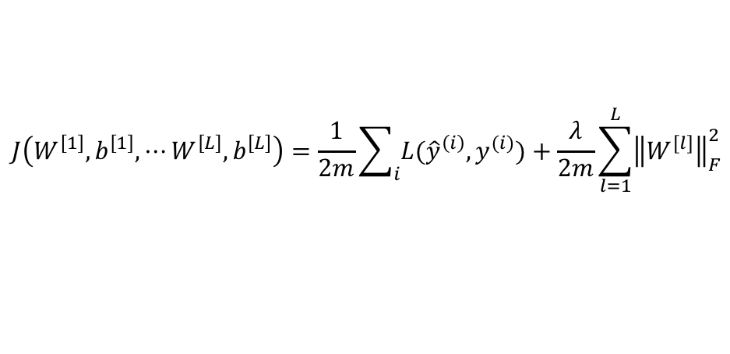
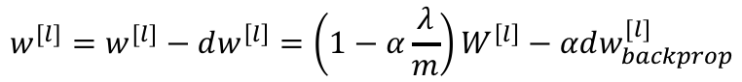
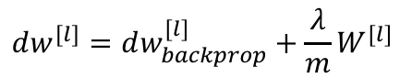
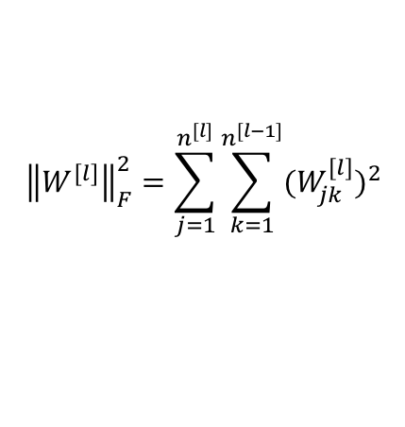
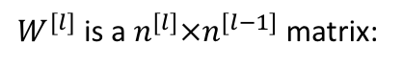
L2 regularization for neural network
$$J\left(W^{\left[1\right]},b^{\left[1\right]},⋯W^{\left[L\right]},b^{\left[L\right]}\right)=\frac{1}{2m}\sum_{i}{L({\hat{y}}^{\left(i\right)},y^{(i)})}+\frac{λ}{2m}\sum_{l=1}^{L}{{\left\|W^{[l]}\right\|}_{F}^{2}}$$
$${\left\|W^{[l]}\right\|}_{F}^{2}=\sum_{j=1}^{n^{[l]}}{\sum_{k=1}^{n^{[l−1]}}{{(W_{jk}^{[l]})}^{2}}}$$
$W^{[l]}$ is a $n^{[l]}×n^{[l−1]}$ matrix:
“Frobenius norm” of a matrix
$$dw^{[l]}=dw_{backprop}^{[l]}+\frac{λ}{m}W^{[l]}$$
$$w^{[l]}=w^{[l]}−dw^{\left[l\right]}=\left(1−α\frac{λ}{m}\right)W^{\left[l\right]}−αdw_{backprop}^{[l]}$$
A.k.a., weight decay

Slide 6
L2 regularization in TensorFlow and PyTorch
TensorFlow: use tf.nn.l2_loss
Add additional terms when defining loss function
loss = (tf.reduce_mean(
tf.nn.softmax_cross_entropy_with_logits(…))
+ 0.01*tf.nn.l2_loss(hidden_weights)
+ 0.01*tf.nn.l2_loss(out_weights)
PyTorch: use the weight_decay argument when define the optimizer
optimizer = torch.optim.SGD(model.parameters(),
lr=0.1, momentum=0.9,
weight_decay=0)

Slide 7
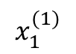
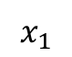
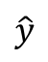
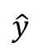
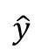
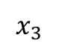
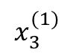
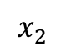
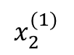
Dropout regularization
Dropout units in hidden layers
No dropout
$$x_{1}$$
$$x_{2}$$
$$\hat{y}$$
$$x_{1}$$
$$x_{3}$$
$$x_{2}$$
$$\hat{y}$$
$$x_{3}$$
$$x_{1}^{(1)}$$
$$x_{2}^{(1)}$$
$$\hat{y}$$
$$x_{3}^{(1)}$$

Slide 8
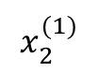
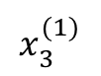
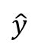
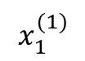
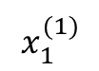
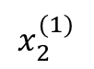
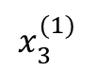
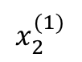
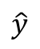
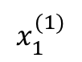
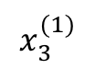
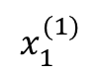
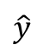
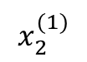
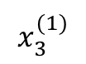
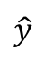
Random dropout for different input examples
For input example 1
For input example 2
$$x_{1}^{(1)}$$
$$x_{1}^{(1)}$$
$$x_{2}^{(1)}$$
$$\hat{y}$$
$$x_{2}^{(1)}$$
$$\hat{y}$$
$$x_{3}^{(1)}$$
$$x_{3}^{(1)}$$
$$x_{1}^{(1)}$$
$$x_{1}^{(1)}$$
$$x_{2}^{(1)}$$
$$\hat{y}$$
$$x_{2}^{(1)}$$
$$\hat{y}$$
$$x_{3}^{(1)}$$
$$x_{3}^{(1)}$$

Slide 9
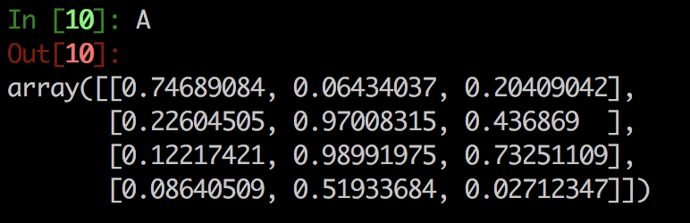
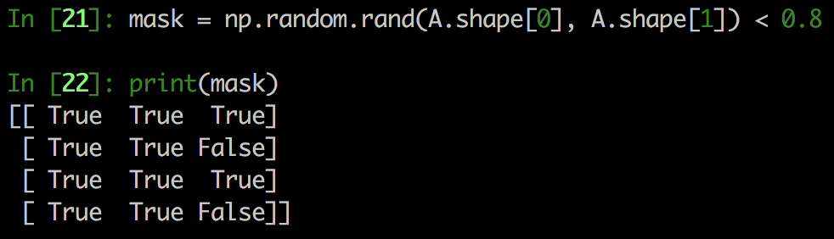
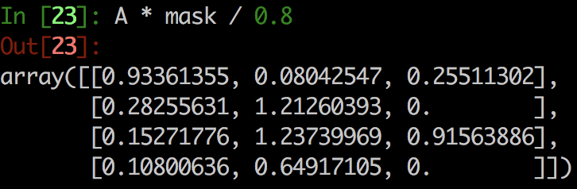

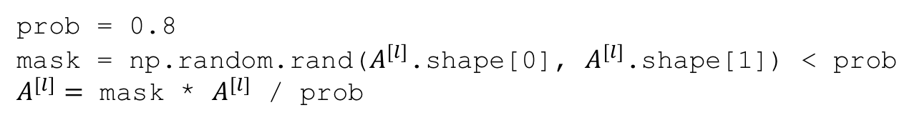
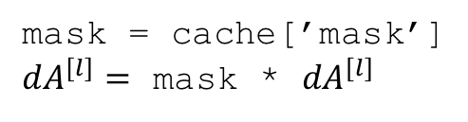
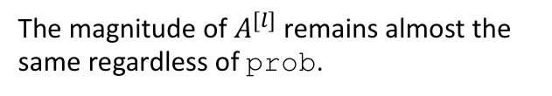
Implementation of dropout
Use a “mask” of 0 and 1 to multiply with the activations from all layers
The mask is randomly generated according to a “keep” probability
Forward
prob = 0.8
mask = np.random.rand($A^{[l]}$.shape[0], $A^{[l]}$.shape[1]) < prob
$A^{[l]}=$ mask * $A^{[l]}$ / prob
“Inverted dropout”
Scale up $A^{[l]}$ to its expected values
Backward
The magnitude of $A^{[l]}$ remains almost the same regardless of prob.
mask = cache[’mask’]
${dA}^{[l]}=$ mask * ${dA}^{[l]}$
Makes test time easier, so that don’t need to
scale the testing data

Slide 10
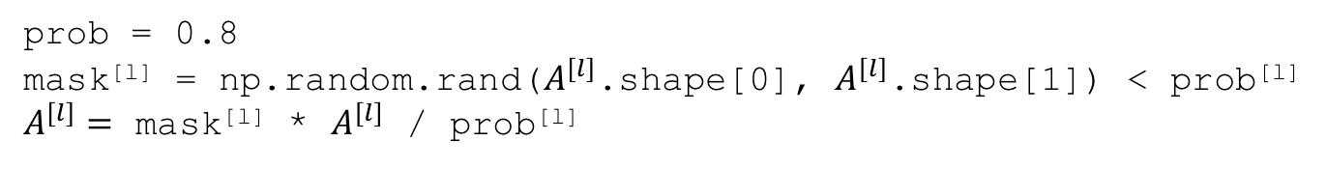
Implementation of dropout (cont.)
Probability to keep units may vary across layers
prob = 0.8
mask^{[l]} = np.random.rand($A^{[l]}$.shape[0], $A^{[l]}$.shape[1]) < prob^{[l]}
$A^{[l]}=$ mask^{[l]} * $A^{[l]}$ / prob^{[l]}
Higher drop probability (lower keep probability) for layer 1 and 2
$$x_{1}$$
$$x_{2}$$
$$\hat{y}$$
$$x_{3}$$

Slide 11
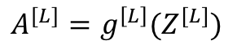
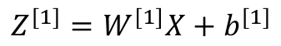
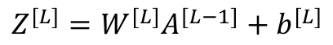
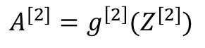
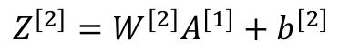
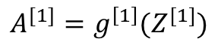
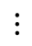
Not dropout at test times
Use just regular forward pass to make predictions
$$Z^{[1]}=W^{[1]}X+b^{[1]}$$
$$A^{[1]}=g^{\left[1\right]}(Z^{[1]})$$
$$Z^{[2]}=W^{[2]}A^{[1]}+b^{[2]}$$
$$A^{[2]}=g^{\left[2\right]}(Z^{[2]})$$
$$⋮$$
$$Z^{[L]}=W^{[L]}A^{[L−1]}+b^{[L]}$$
$$A^{[L]}=g^{\left[L\right]}(Z^{[L]})$$

Slide 12
Effect of dropout
Less overfit = higher training loss
trade-off
Less error rate in testing set = less overfit

Slide 13
Dropout in TensorFlow and PyTorch
TensorFlow: tf.nn.dropout
a1 = tf.nn.relu(tf.add(tf.matmul(x, weights_hiden), biases_hidden))
drop_out = tf.nn.dropout(a1, keep_prob)
a2 = tf.matmul(drop_out, weights_out) + biases_out
PyTorch: nn.Dropout
(import torch.nn as nn)
model = nn.Sequential(
nn.Linear(input_size, 64)
nn.ReLU()
nn.Dropout(0.2)
nn.Linear(64, 10)
)
probability to drop

Slide 14
Why does dropout work?
Intuition:
For each iteration
Using a smaller network
Fewer parameters
Intuition:
Because all units are randomly eliminated:
Cannot rely on certain features
Have to spread out weights
Making generic predictions, instead of describing
idiosyncrasy

Slide 15
Recap
Dropout is to avoid overfitting
Do not need to use it if there is no overfitting
Almost always used in computer vision applications
Lack of training data
Large number of parameters
Easy to overfit
Biological correlates
What the neurons in brain do is similar to dropout
https://www.youtube.com/watch?v=VIRCybGgHts Geoffrey Hinton’s talk at Stanford

Slide 16
Other regularization methods
One cause of overfitting: not enough data
Too expensive to collect and label?
Create some!
Images from https://medium.com/nanonets/how-to-use-deep-learning-when-you-have-limited-data-part-2-data-augmentation-c26971dc8ced
Data augmentation: make minor changes to existing data and treat them as new data
Flip
Rotate
Crop
Add noise

Slide 17
Vanishing and exploding gradients
For deep neural network, gradients (derivatives) can get extremely big or small
Making training difficult
Notes:
One of the problems of training NN, especially very deep NN, is vanishing and exploding gradients.
I.e., your derivatives can sometimes either get very very big, or very very small – making training difficult.

Slide 18
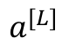
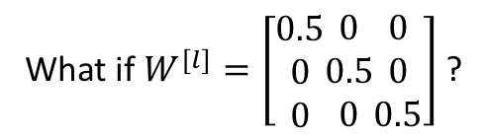









How does this happen?
$$x_{1}$$
$$a^{[L]}$$
$$x_{2}$$
$$\hat{y}$$
$$x_{3}$$
For simplicity, $b^{[l]}=0$, $g^{\left[l\right]}\left(z\right)=z$
$$a^{[L]}=W^{[L]}a^{[L−1]}=W^{[L]}W^{[L−1]}a^{[L−2]}=W^{[L]}W^{[L−1]}⋯W^{[1]}X$$
If $W^{[l]}=\left[\begin{matrix}1 \\ 0 \\ 0\end{matrix}\begin{matrix}0 \\ 1 \\ 0\end{matrix}\begin{matrix}0 \\ 0 \\ 1\end{matrix}\right]$, it works fine
What if $W^{[l]}=\left[\begin{matrix}2 \\ 0 \\ 0\end{matrix}\begin{matrix}0 \\ 2 \\ 0\end{matrix}\begin{matrix}0 \\ 0 \\ 2\end{matrix}\right]$ ?
What if $W^{[l]}=\left[\begin{matrix}0.5 \\ 0 \\ 0\end{matrix}\begin{matrix}0 \\ 0.5 \\ 0\end{matrix}\begin{matrix}0 \\ 0 \\ 0.5\end{matrix}\right]$ ?
$$a^{[L]}=2^{L}X$$
$$a^{[L]}=2^{−L}X$$
${da}^{[1]}∝{da}^{[2]}W^{[2]}∝{da}^{[3]}W^{[3]}$ $W^{[2]}={da}^{[L]}W^{[L]}W^{[L−1]}⋯W^{[2]}$
Explode
Gradient is the exponential function of layer number
Vanish

Slide 19






How to (partially) avoid vanishing and exploding gradients
$$z_{i}=w_{i}a_{i}→Var\left(z_{i}\right)=E\left(w_{i}\right)Var\left(a_{i}\right)+E\left(a_{i}\right)Var\left(w_{i}\right)+Var\left(w_{i}\right)Var\left(a_{i}\right)=1$$
Initialize weights properly
Want $w_{i}$ to be small and has a variance close to $\frac{1}{n^{[l−1]}}$
$$a_{1}^{[l−1]}$$
$$z^{[l]}=w_{1}a_{1}^{[l−1]}+w_{2}a_{2}^{[l−1]}+⋯w_{n^{[l−1]}}a_{n^{[l−1]}}^{[l−1]}$$
$$a_{2}^{[l−1]}$$
Common practice:
$W^{[l]}=$ np.random.randn()*np.sqrt($\frac{1}{n^{[l−1]}}$)
$$⋮$$
“Xavier initialization”
$$a_{n^{[l−1]}}^{[l−1]}$$
For ReLU activation function:
$W^{[l]}=$ np.random.randn()*np.sqrt($\frac{2}{n^{[l−1]}}$)
Note: proper initialization helps reduce vanishing and exploding gradients, but does not solve it all at once

Slide 20
Weight initialization in TensorFlow and PyTorch
TensorFlow: tf.contrib.layers.xavier_initializer
initializer = tf.contrib.layers.xavier_initializer()
w1 = tf.Variable(initializer(w1_shape))
b1 = tf.Variable(initializer(b1_shape))
PyTorch: torch.nn.init.xavier_normal_
w = torch.empty(3, 5)
nn.init.xavier_normal_(w)

Slide 21
Another way of dealing with exploding gradients
Clipping: Limit the magnitude of gradients manually
TensorFlow: tf.clip_by_norm or tf.clip_by_value
optimizer = tf.train.AdamOptimizer(learning_rate=learning_rate)
gvs = optimizer.compute_gradients(cost)
capped_gvs = [(tf.clip_by_value(grad, -1., 1.), var) for grad, var in gvs]
train_op = optimizer.apply_gradients(capped_gvs)
PyTorch: torch.nn.utils.clip_grad_norm or torch.nn.utils.clip_grad_value_

Slide 22

Gradient checking
How to check if your computation of $dW$ and $db$ are correct?
Use a approximate way to compute $\frac{∂J}{∂W}$ and $\frac{∂J}{∂b}$, and compare with $dW$, $db$, hoping they do not differ too much
Approximate: $\frac{∂J(W, b)}{∂W}=\frac{J\left(W+ε,b\right)−J(W−ε,b)}{2ε}$, $\frac{∂J(W, b)}{∂b}=\frac{J\left(W,b+ε\right)−J(W,b−ε)}{2ε}$
Check if $\frac{∂J(W, b)}{∂W}≈dw$, and $\frac{∂J(W, b)}{∂b}≈db$

Slide 23

Gradient checking (how to)
Extract all parameters: $W^{[1]},b^{[1]},⋯W^{[L]},b^{[L]}$, and reshape into a long vector $θ$
For each $i$, compute the approximated gradient by ${dθ}_{i}^{′}=\frac{J\left(θ_{i}+ε\right)−J(θ_{i}−ε)}{2ε}$
Compute the Euclidean distance between $dθ^{′}$ (approximate) and $dθ$ (actual gradient computed from backprop), and normalize it
$D=\frac{{\left\|dθ^{′}−dθ\right\|}_{2}}{{\left\|dθ^{′}\right\|}_{2}+{\left\|dθ\right\|}_{2}}<ε={10}^{−7}$
Problematic values: $D={10}^{−3}$

Slide 24
Next lecture
Batch normalization
Layer normalization

